Slide 1

MathFast
Mid-year Data Evaluation

Slide 2
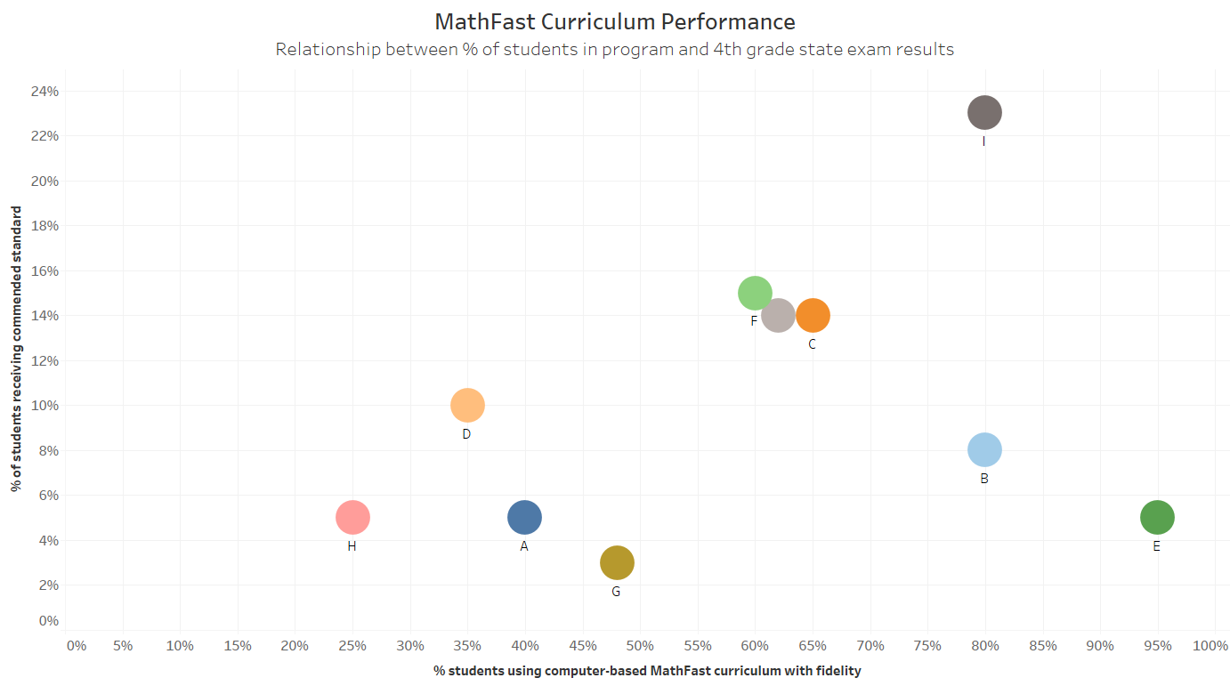

Overall Performance

Slide 3
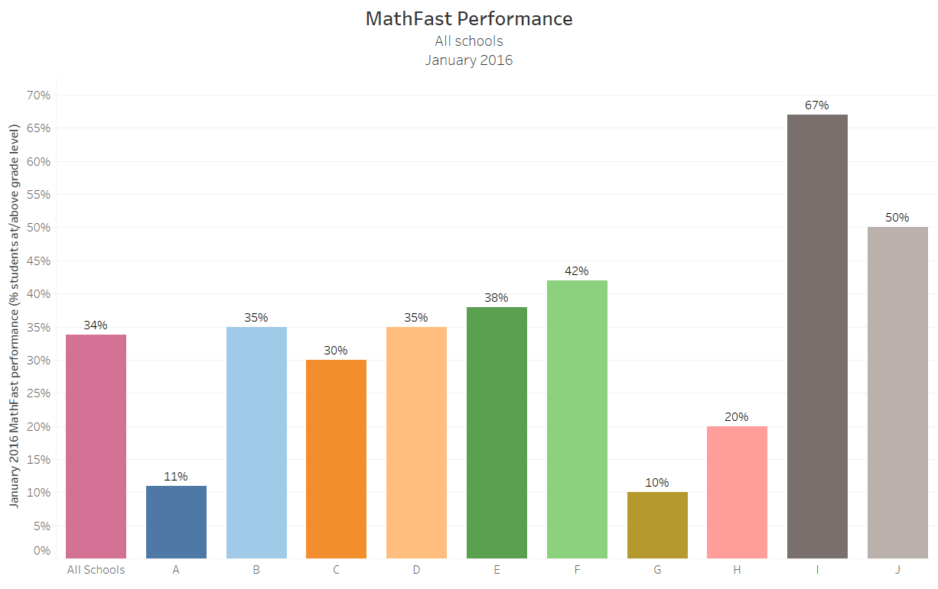
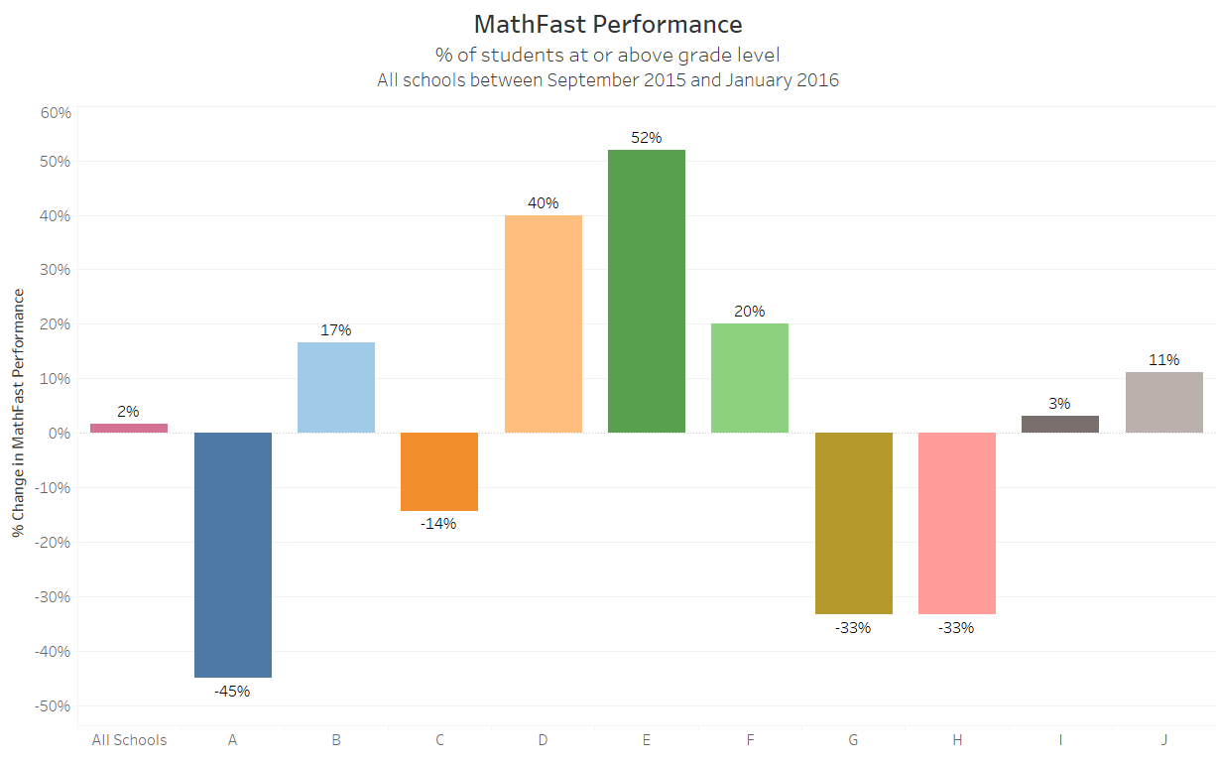
School Performance
 | School | % Change | Partners
January High | I | 3% | No additional support
January Low | G | -33% | Regional
Greatest % Change | E | 52% | Technology Curriculum Regional
Least % Change | A | -45% | Regional

Slide 4
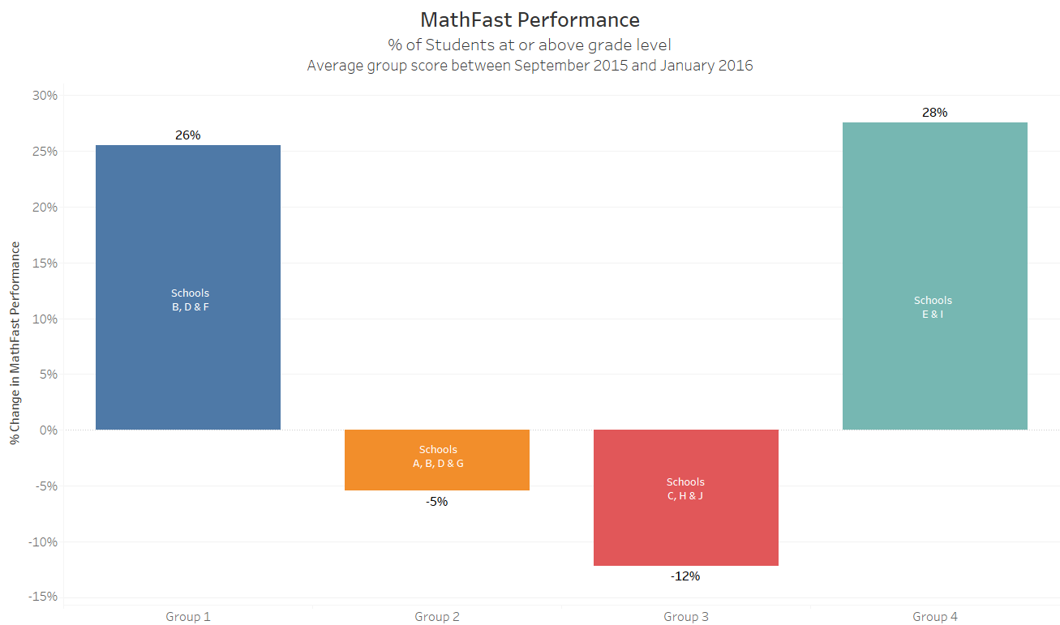
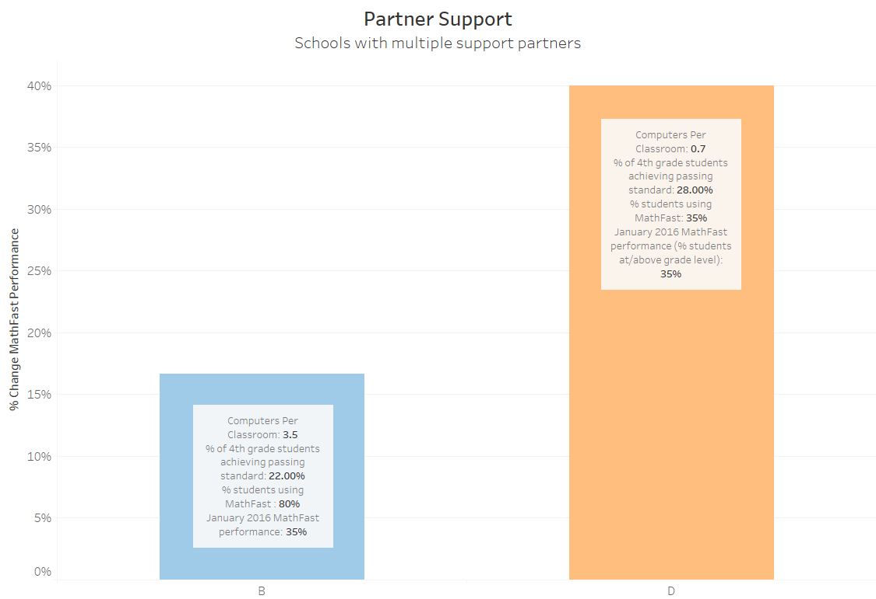
Partner Support
Group | Schools | Partner Support | % Change in MathFast Scores September 2015 to January 2016
Group 1 | B, D, F | Technology Curriculum | 28%
Group 2 | A, B, D, G | Regional | -12%
Group 3 | C, H, J | Local | -5%
Group 4 | E, I | No Additional | 26%

Slide 5
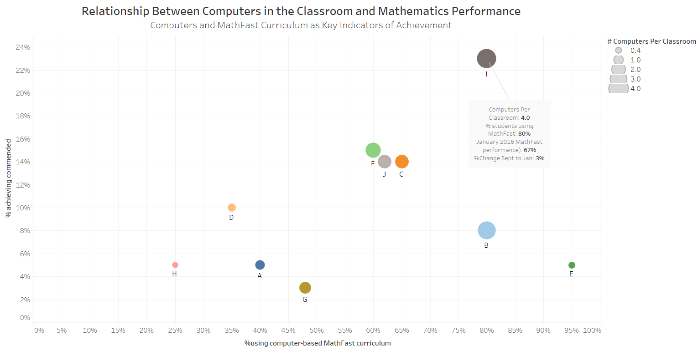
Technology and the Classroom

